Slide 1

SENG 461 – TERM PROJECT
AI Language Detector & Translator
Instructor: Yüksel Arslan
Students Name & Id:
Melih Polat 220204043
Berkay Çevirici 220204054
Arhan Ataş 230205018

Slide 2

Team members & Responsibilities
Backend & System Developer : Berkay Çevirici
Frontend & Database Developer : Arhan Ataş
Frontend Developer : Melih Polat

Slide 3
The purpose of the site
This project is a secure web application that automatically detects the language of the text entered by users and translates it into the selected target language and includes role-based authorization.
Increased content production in different languages.
The susceptibility of manual language selection to errors.
The need for secure user management.
In line with these problems, an automated, fast, and secure solution has been aimed for.
Automatically detecting the text language.
Providing translation to multiple target languages.
Managing the system with user and admin roles.
Offering a modular and scalable architecture.

Slide 4
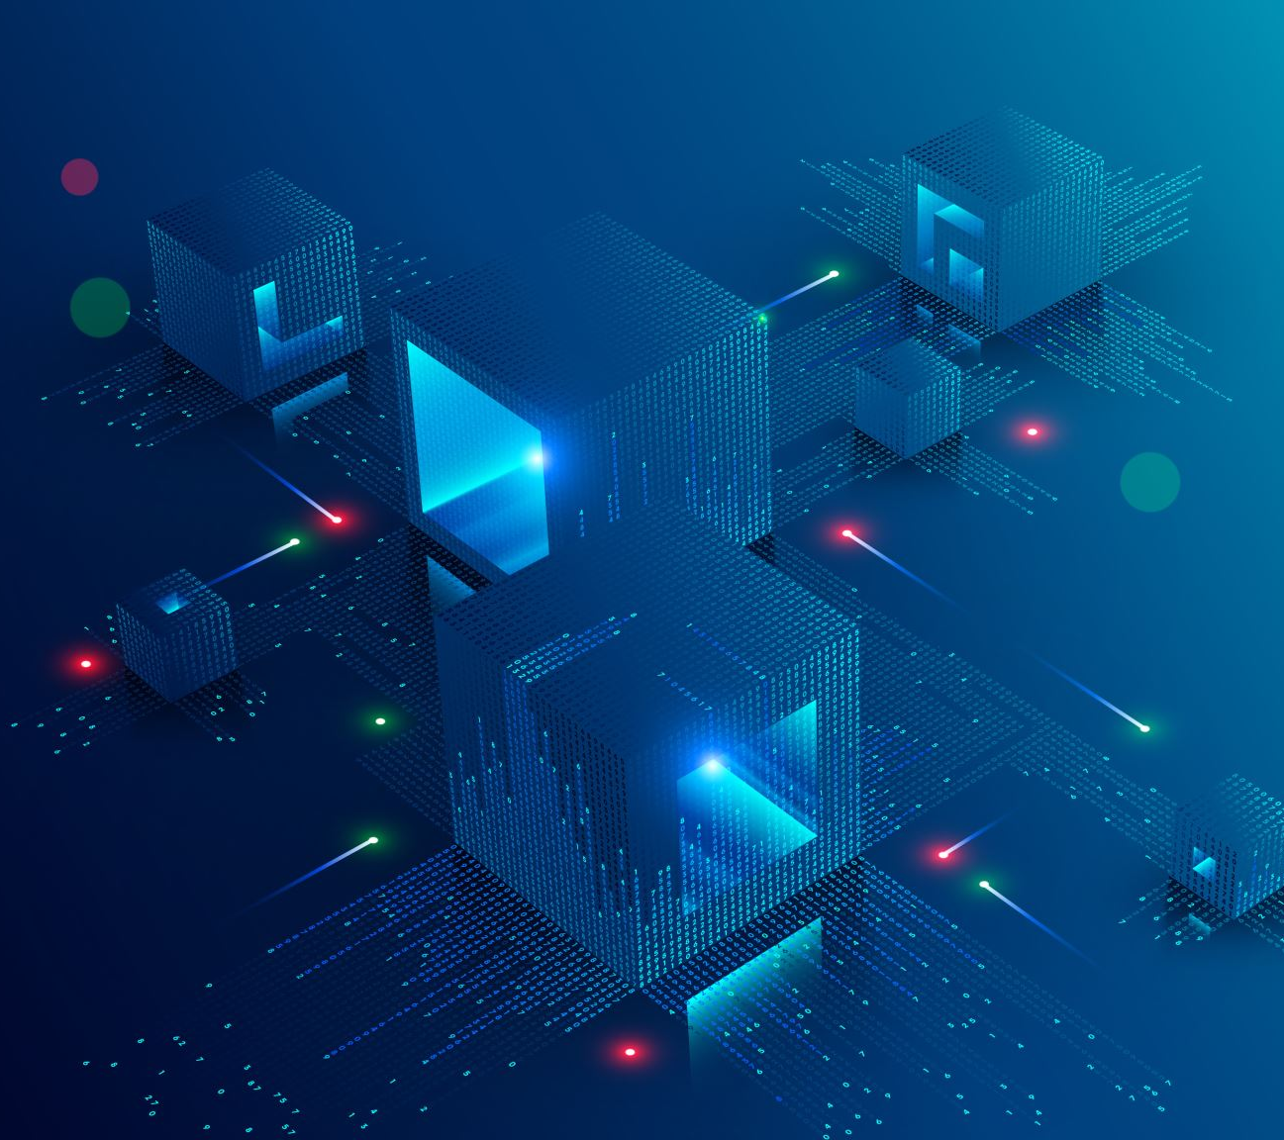
System Architecture
MVC-like layered structure
Frontend: HTML / Jinja Templates
Backend: Flask Routes & API
Database Layer: SQLAlchemy ORM
External APIs: Language detection and translation services

Slide 5
Technologies used
Backend: Python, Flask
Database: SQLite, SQLAlchemy ORM
Authentication: Flask-Login
API Services: DetectLanguage API

Slide 6
Database
In this project, SQLite was chosen as the database management system due to its lightweight, server-independent structure and portability.
Database operations were performed using an object-oriented approach via Python classes (Class structure) using SQLAlchemy ORM instead of raw SQL queries.
For user security; session management was provided with Flask-Login, and passwords were stored in the database not as plain text, but hashed using the Werkzeug Security (Scrypt/SHA) library.
By implementing Role-Based Access Control (RBAC) architecture, access to the administration panel and critical operations is restricted only to users with 'admin' privileges.
During schema changes in the development process, the database was rebuilt to ensure data consistency and resolve model-structure inconsistencies.

Slide 7
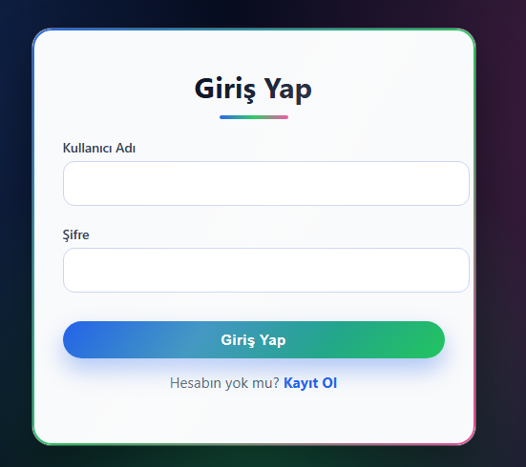
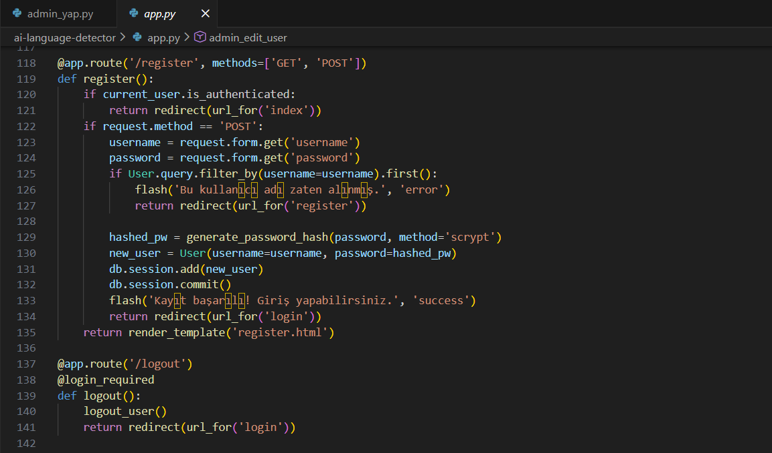
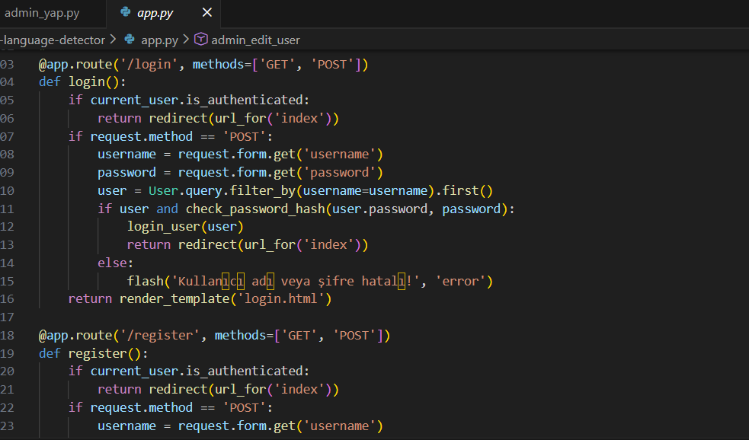
Database Design
Using Login required decorator
id (Primary Key)
username (Unique)
Passwords are stored in hashed form (scrypt)
password (Hashed)
Preventing unauthorized admin Access and Session-based authentication
Role (user / admin)

Slide 8
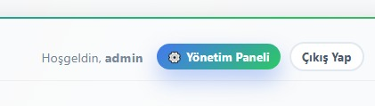

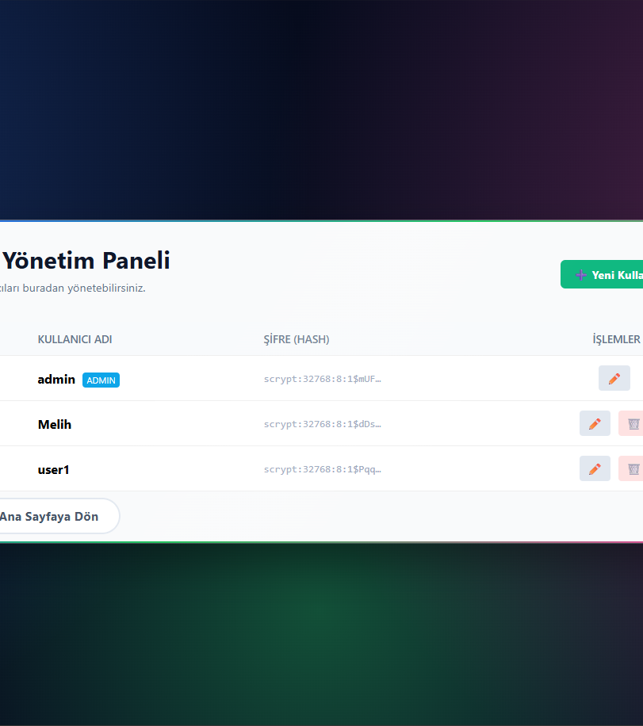
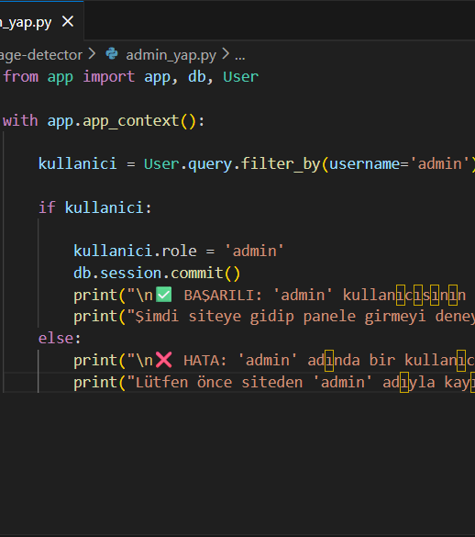
User & Admin Panel
User Panel :
Register: Create a new user
Login: Identity Verification
Logout: Logging out
Preventing unauthorized access
Admin panel :
Read: Listing all users
Create: Adding a new user
Update: Updating user information
Delete: Deleting a user (Admin protected)

Slide 9
Backend
The application's backend structure was developed using Python and the Flask framework.
The server receives data from the client and first identifies the source language using a language detection API.
The detected language is translated into the target language selected by the user via a translation API.
API keys are managed through environmental variables, creating a secure structure.
Error conditions are handled with appropriate HTTP status codes and JSON responses.
Uncontrolled API usage has been prevented by supporting only specific target languages.

Slide 10
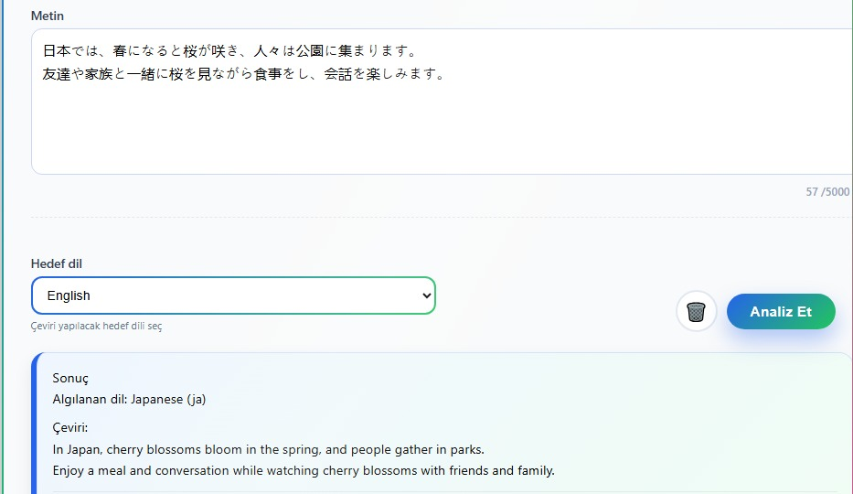
Language Detection Process & Translation Process
Language Detection Process:
User enters text
DetectLanguage API is called
Text language is obtained
Grammar is transferred to the translation module
Translation Process:
Source language is automatically determined
Target language is selected by the user
Translation is done with MyMemory API
The result is returned to the user in JSON format

Slide 11
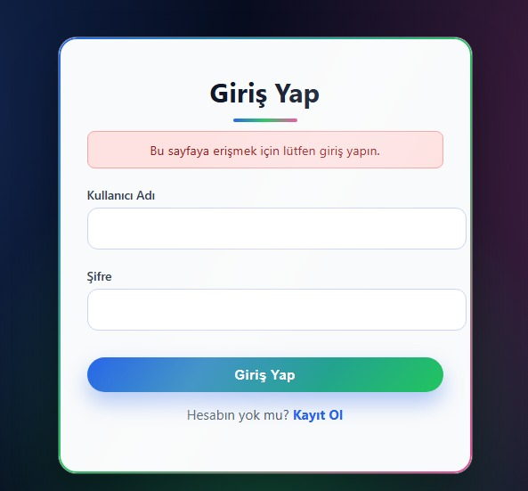
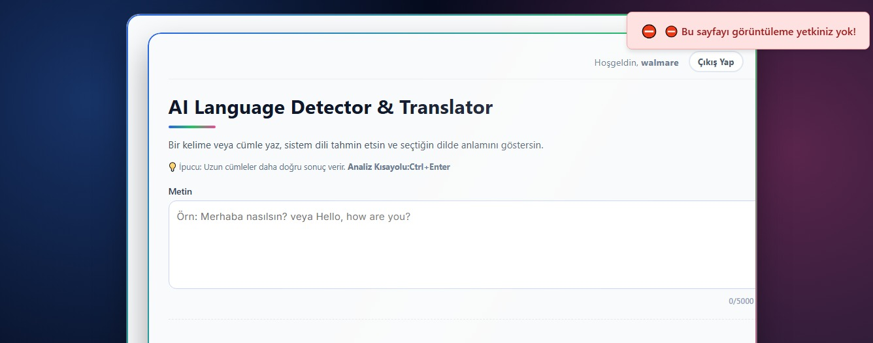
Error Management
Empty text check
Catching API errors
User-friendly error messages
Server-side exception handling

Slide 12
Frontend
The application's user interface is structured with HTML to include text input, target language selection, and result display components.
The page structure is dynamically generated by the server using Flask's template system.
A card-based, modern, and simple design has been implemented using CSS; visual consistency is ensured with color gradients and shading effects.
Thanks to responsive design principles, the application is compatible with desktop and mobile devices.
Visual feedback elements such as character counters, result fields, and notifications are designed to enhance the user experience.
An automatically expanding textarea structure has been implemented for long texts received from the user.
Visual feedback is provided to the user by using hover and focus effects for buttons and interactive areas.

Slide 13
JavaScript
The text and target language information received from the user are sent asynchronously to the server via JavaScript.
The analysis and translation results returned from the server are dynamically displayed on the screen without refreshing the page.
Basic interactions such as loading status, error checking, and keyboard shortcuts are managed with JavaScript.
Displaying the translation result with a writing animation enhances the user experience.
Additional functions such as text copying and text-to-speech are provided on the client side.

Slide 14
Project Strengths & Result
Automatic language detection
Real API integration
Admin panel and authorization
Clean and readable code structure
This project demonstrates the fundamental building blocks of web-based language processing systems in a practical way.
It offers an extensible software architecture suitable for academic and real-world scenarios.

